Slide 1
How's My Driving?
Accelerometer App for iPhone
by Ruaidhri Hallinan
11277084
UCD 2013 - Comp 41550

Slide 2
What it does - Part 1
Uses Accelerometer
- Measure G-Forces of driving
- On x,y,z Triaxial Instruments
Uses Location Manager
- Location
- Distance
- Speed
- Course
- Altitude

Slide 3
What it does - Part 2
Logs exceptions in Driving Behaviour

Slide 4
How does it log exceptions?
Uses algorithms to detect:
- Harsh Braking
- Harsh Acceleration
- Unsafe Cornering
- Unsafe Bump (pothole)

Slide 5
Algorithms?
Based on a paper from 2009 International Conference on Computational Science and Engineering:
Are You A Safe Driver (Android)
by
Lonnie Langle
Ram Dantu
University of North Texas

Slide 6
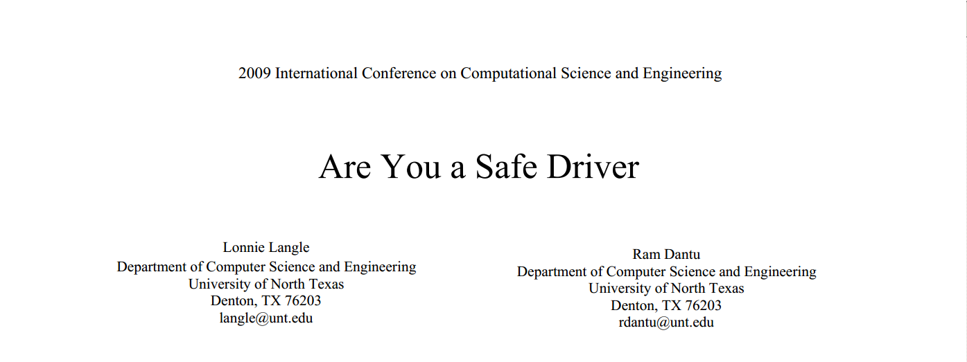
Credit

Slide 7
What did they do?
Gave some measurements with Smartphone Accelerometers, to measure driving behaviour (with Androids).

Slide 8
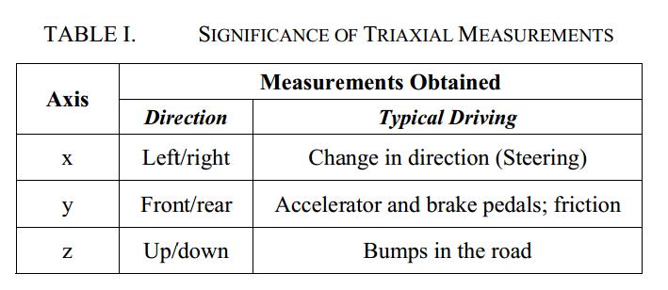
Algorithms based on...

Slide 9
Is iOS / iPhone much different?
Different values, same principals...

Slide 10
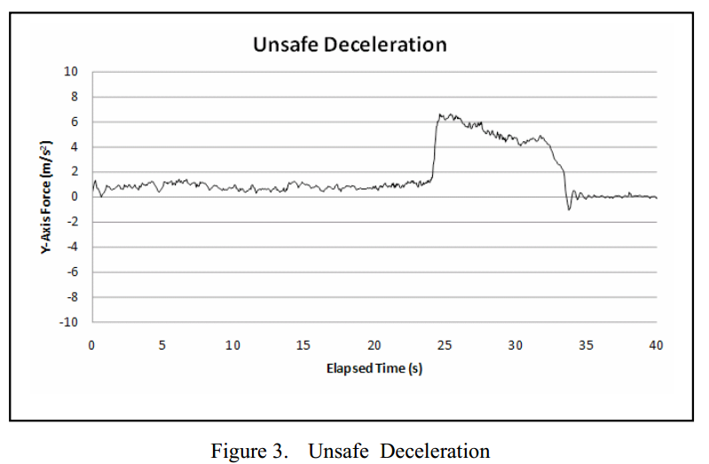
Example: Harsh Breaking

Slide 11
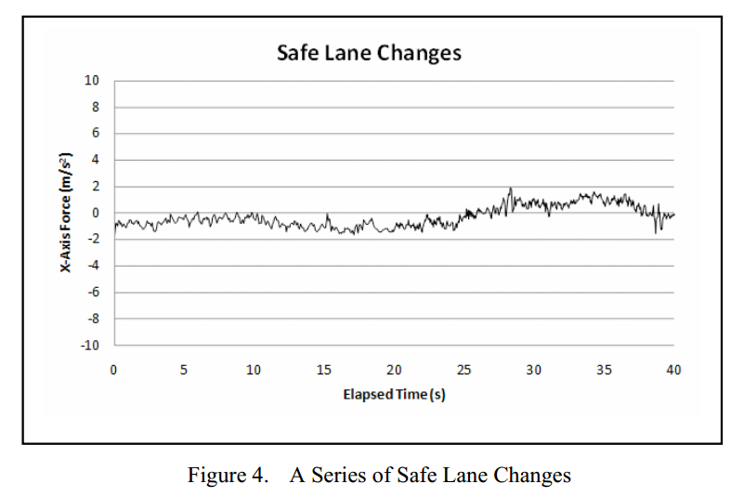
Example: Safe Cornering

Slide 12
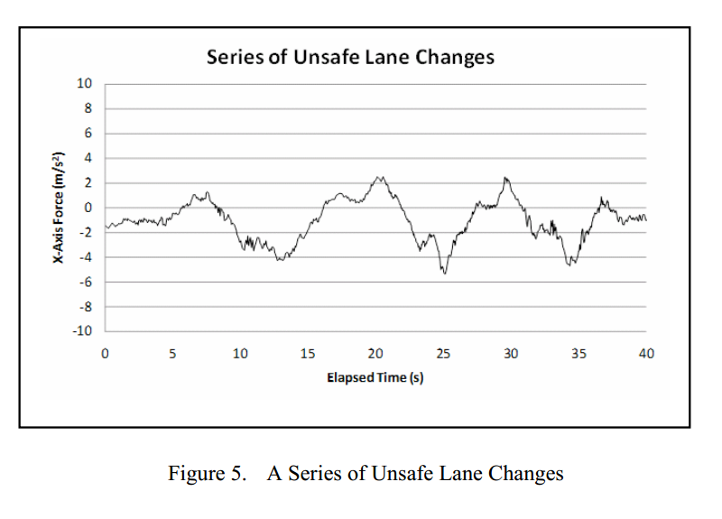
Example: Bad Cornering

Slide 13
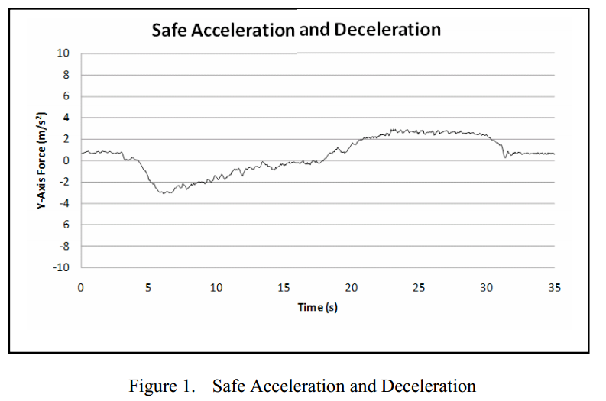
Example: Safe Acceleration

Slide 14
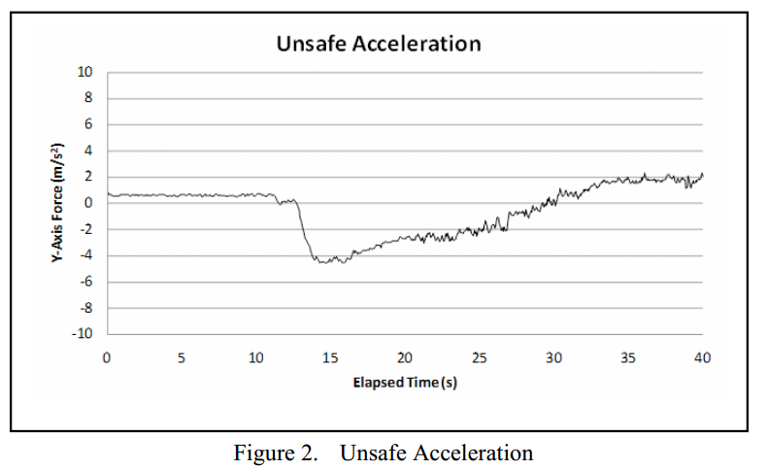
Example: Unsafe Acceleration

Slide 15
What then?
- Show the Driving Exceptions in a UIPicker
- User can select the Exception and view details of the exception including:
- Type
- Speed
- Time
- Location

Slide 16
And...
Rate the Drivers behaviour with different slogans from driving references from Miss Daisy right through to Too Fast Too Furious, depending on the amount of exceptions.
Also, using Social Framework so people can share their rating on Twitter or Facebook

Slide 17
Simulator Demo
Device Demo

